Slide 1
CS60064 Spring 2022 Computational Geometry
Instructors
Bhargab B. Bhattacharya (BBB)
Partha Bhowmick (PB)
Lecture 01
05 January 2022
Indian Institute of Technology Kharagpur
Computer Science and Engineering
Notes:
Good Morning!
The title of today’s talk is “On some Planar Partitioning Problems”.

Slide 2
Class Schedule
Wednesday: 10:00 – 10:55
Thursday: 09:00 – 09:55
Friday: 11:00 – 11:55
Can we merge the classes scheduled on Thursday and Friday into a two-hour slot on Friday (11:00 – 12:50)?
Notes:
Good Morning!
The title of today’s talk is “On some Planar Partitioning Problems”.

Slide 3
Teaching Assistants
Faraaz Rahaman Mallick (faraazrm@gmail.com)
Sashank Bonda (sashank729@gmail.com)
Course Page
https://moodlecse.iitkgp.ac.in/moodle/login/index.php
Moodle Student Registration Key for the Course: STUBBPB22

Slide 4
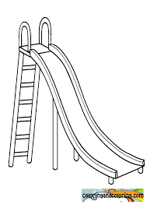
What is the path of fastest descent of an object from a point A to point B?
Brachistochrone: A cycloid upside-down. This is the path down which a particle will travel in the shortest time. This problem was first proposed by John Bernouilli in 1696, soon after the birth of calculus.
Newton solved it in a single night using calculus!
A
A
B
B

Slide 5
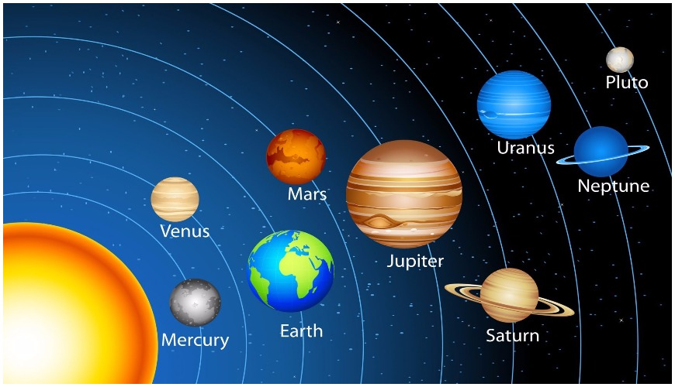

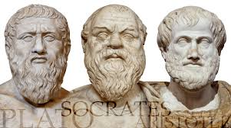
Geometry Everywhere
God forever geometrizes
Plato (Circa 424 – 348 BC)

Slide 6
Warm-Up Examples
Notes:
Good Morning!
The title of today’s talk is “On some Planar Partitioning Problems”.

Slide 7
Why Geometric problems are so special?
Given two polygons P and Q, determine P ∩ Q
R
CG = Geometric properties +
data structures + algorithms + coding
Place R such that it encloses maximum number of points

Slide 8
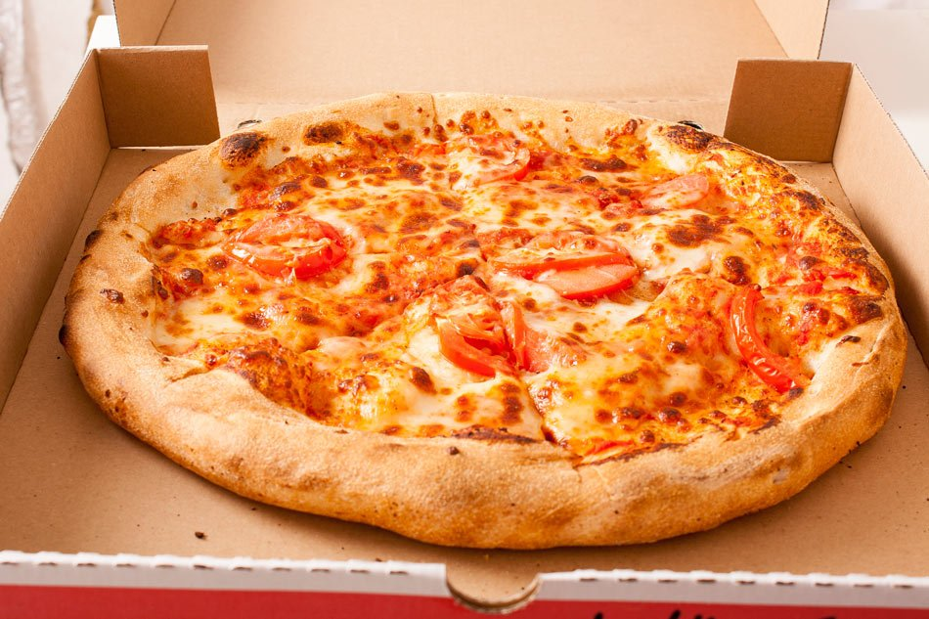
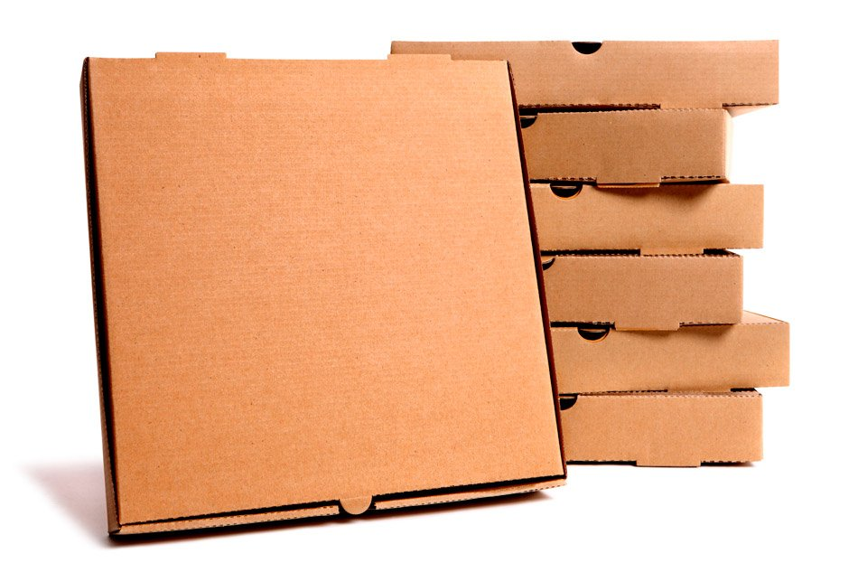
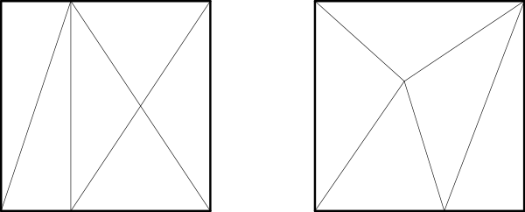
Why pizzas are supplied in square boxes, round in shape, and eaten in triangles?
A square-box can be constructed by folding a single sheet of card board, with certain cuts!
A round-box cannot be constructed by folding a single sheet
Monsky's theorem (1970): it is not possible to dissect a square into
an odd number of triangles of equal area
Proof: Self-study

Slide 9
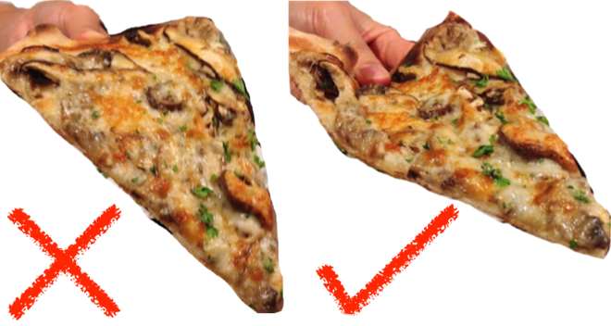
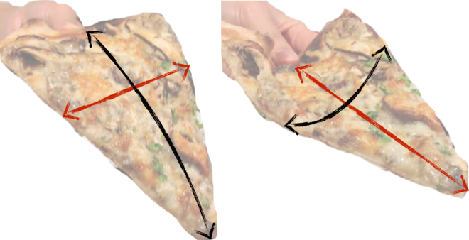

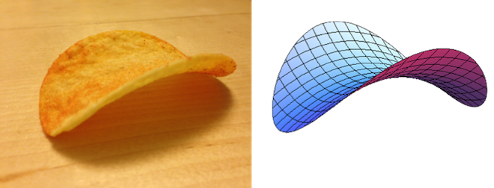

Why pizzas are supplied in square boxes, round in shape, and eaten in triangles?
Gaussian curvature of a point in a surface: product of curvatures of the most convex and most concave paths
Courtesy: Aatish Bhatia, The WIRE, 2017

Slide 10
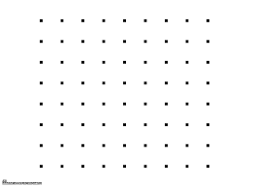
A Non-Sense (?) Problem
The Sylvester-Gallai Theorem
J. J. Sylvester posed in 1893
Remained unsolved for 50 years!
T. Gallai first proved it in 1944
Claim: Given a finite set P of n points in the 2D plane, either
all the points are collinear, or there exists at least one line passing
through exactly two points in P.

Slide 11
Sylvester-Gallai Theorem: Kelly’s Proof After 40 years, in 1986, Kelly provided a short and elegant proof!
L′
p
L
A
B
C
Proof:
Let L be a line passing through two points A, B and p ∈ P but ∉ L, such that dist(p, L) is minimum among all such (L, p) tuple;
Assume L also passes through a third point C ∈ P; ⇒ ∃ (L′, B) s.t. dist(B, L′ ) < dist(p, L), contradiction!
Claim: Given a finite set P of n points in the 2D plane, either all the points are collinear, or there exists at least one line passing through exactly two points in P. Such a line is called an “ordinary line”.

Slide 12
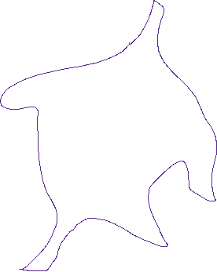
Toeplitz conjecture (the inscribed square problem or the square-peg problem):
Question: Does every Jordan curve admit an inscribed square? That is, does every simple closed curve in the plane contain four vertices of a square?
In 1911, Otto Toeplitz posed the question, however, it still remains unsolved

Slide 13
CS60064 Spring 2022 Computational Geometry
Instructors
Bhargab B. Bhattacharya (BBB)
Partha Bhowmick (PB)
Lecture 02
06 January 2022
Indian Institute of Technology Kharagpur
Computer Science and Engineering
Notes:
Good Morning!
The title of today’s talk is “On some Planar Partitioning Problems”.

Slide 14
Warm-Up Examples (contd..)
Notes:
Good Morning!
The title of today’s talk is “On some Planar Partitioning Problems”.

Slide 15
Euclidean Straight Line
Euclidean: Two straight lines are either parallel or
intersect at a unique point
A
B
B
A

Slide 16
Grid (Digital) Geometry: Dilemma of Intersection
two intersecting Euclidean straight lines
⇒ the corresponding object sets are disjoint!
Take an image of this object using a camera
A straight line now becomes a set of grid points

Slide 17

Computational geometry and related fields
Discrete and combinatorial geometry: study of existential and extremal problems
Computational geometry: mostly in Euclidean space; algorithmic solutions to geometric problems, geometric data structures; applications to robotics, GIS, scientific computing, facility location, computational biology, graphics
Digital geometry: properties of pixels and algorithms in discrete lattice space
→ applications to image analysis, computer graphics,
computer vision, computer art

Slide 18
Warming Up: Starting with a Simple Puzzle of CG…
O(n)
median
Given n points on the 2D plane where n is an odd number > 5, find a rectangle touching a point such that it encloses exactly half of the remaining points. Assume no two points have the same x-coordinate.

Slide 19
Making the puzzle little more difficult
O(n⁴)?
Does it always exist?
Halving-circle problem
Given n points on the 2D plane where n is an odd number > 5, find a circle passing through three points such that it encloses exactly half of the remaining points. Assume no four points are concyclic.
Jaime Rangel-Mondragon, "Problems on Circles II: Halving a Set of Points" http://demonstrations.wolfram.com/ProblemsOnCirclesIIHalvingASetOfPoints/; Wolfram Demonstrations Project Published: March 7 2011

Slide 20
Making the puzzle little more difficult
Halving-circle problem
O(n)?
c
α
no four points are concyclic
β
α < β < γ
γ
b is the lowest point; a is the point that makes the least angle clock-wise, with the horizontal line passing through b. Both points can be identified in O(n) time.
a b
Claim: The angle subtended by the line segment ab to each of the n points must be distinct; Let c is the point where the subtended angle is the median.
Separating circle will pass through a, b, c

Slide 21
Problem
Generate instances of n random points
(n = 10r +3, r: integer > 1) on the plane,
Construct a separating circle that encloses 30% of points in the interior

Slide 22
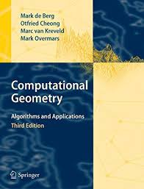
Textbook:
1. D. A. Patterson and J. L. Hennessy, Computer Organization and Design - the Hardware
Software Interface, 5th Edition, Elsevier, Morgan Kaufmann, 2014.
2. Older Editions of the same book [2nd Ed. (1998), 3rd Ed. (2005), 4th Ed. (2012)], and newer
RISC V (2018) Edition may also be referred to while discussing some topics).
Textbook and Notes
M. de Berg, O. Cheong, M. van Kreveld, and M. Overmars: Computational Geometry: Algorithms and Applications (3rd edition), Springer Verlag, 2008 (commonly known as
4A-Book as there are four authors)
David M. Mount: CMSC 754 Computational Geometry Lecture Notes, Department of Computer Science,
University of Maryland 2002
(http://www.cs.umd.edu/~mount/754/Lects/754lects.pdf)

Slide 23
Textbook:
1. D. A. Patterson and J. L. Hennessy, Computer Organization and Design - the Hardware
Software Interface, 5th Edition, Elsevier, Morgan Kaufmann, 2014.
2. Older Editions of the same book [2nd Ed. (1998), 3rd Ed. (2005), 4th Ed. (2012)], and newer
RISC V (2018) Edition may also be referred to while discussing some topics).
References
S. L. Devadoss and J. O’Rourke: Discrete and Computational Geometry, Princeton University Press, 2011.
F. Preparata and M. Shamos: Computational Geometry: An Introduction (3rd edition), Springer Verlag,1993.
J. O'Rourke: Computational Geometry in C (2nd edition), Cambridge Univ, Press, 1998.
J. O’Rourke, Art Gallery Theorems and Algorithms, Oxford Univ. Press, 1987.
K. Mulmuley: Computational Geometry: An Introduction Through Randomized Algorithms, Prentice Hall, 1994.
S. Ghosh: Visibility Algorithms in the Plane, Cambridge University Press, 2007.
Jacob E. Goodman, Joseph O'Rourke, and Csaba D. Tóth (Ed.): Handbook of Discrete and Computational Geometry, Third Edition, CRC Press, 2017.
Jiri Matousek: Lectures on Discrete Geometry, Springer, 2002.
Erik D. Demaine and Joseph O'Rourke: Geometric Folding Algorithms: Linkages, Origami, Polyhedra, Cambridge University Press, 2007.
Micha Sharir and Pankaj Agarwal: Davenport Schinzel Sequences and Their Geometric Applications, Cambridge University Press, 2010.
Godfried T. Toussaint, The Geometry of Musical Rhythm, CRC Press, 2013.
Marvin Minsky and Seymour Papert: Perceptrons – An Introduction to Computational Geometry, MIT Press, 1969.

Slide 24
Textbook:
1. D. A. Patterson and J. L. Hennessy, Computer Organization and Design - the Hardware
Software Interface, 5th Edition, Elsevier, Morgan Kaufmann, 2014.
2. Older Editions of the same book [2nd Ed. (1998), 3rd Ed. (2005), 4th Ed. (2012)], and newer
RISC V (2018) Edition may also be referred to while discussing some topics).
Web Resources
NPTEL Video Course on Computational Geometry by Sandeep Sen, Department of Computer Science & Engineering, IIT Delhi, and Pankaj Agarwal, Dept. of CS, Duke University, USA
(http://www.nptelvideos.in/2012/11/computational-geometry.html)
Lecture Slides on Computational Geometry by Martin Held, University of Salzburg, Austria (https://www.cosy.sbg.ac.at/~held)
Godfried T. Toussaint’s page: http://cgm.cs.mcgill.ca/~godfried/teaching.html
CGAL Computational Geometry Library (https://www.cgal.org/)
K. Mehlhorn and St. Näher: The LEDA Platform of Combinatorial and Geometric Computing, Cambridge University Press, 1999 (https://people.mpi-inf.mpg.de/~mehlhorn/LEDAbook.html).
Computational Geometry (Wolfram Research) (http://mathworld.wolfram.com/topics/ComputationalGeometry.html)
David Eppstein's Geometry in Action (https://www.ics.uci.edu/~eppstein/geom.html)
David Eppstein's Geometry Junkyard (https://www.ics.uci.edu/~eppstein/junkyard/)

Slide 25
Textbook:
1. D. A. Patterson and J. L. Hennessy, Computer Organization and Design - the Hardware
Software Interface, 5th Edition, Elsevier, Morgan Kaufmann, 2014.
2. Older Editions of the same book [2nd Ed. (1998), 3rd Ed. (2005), 4th Ed. (2012)], and newer
RISC V (2018) Edition may also be referred to while discussing some topics).
Journals and Conferences
CGTA: Computational Geometry: Theory and Applications
• CGTA: Computational Geometry: Theory and Applications
• DCG: Discrete and Computational Geometry
• IJCGA: International Journal of Computational Geometry
• SoCG: Symposium on Computational Geometry
• CCCG: Canadian Conference on Computational Geometry
Geometry

Slide 26
Grading Policy
Homework/Quiz/Term papers – 50%
Two Tests – 50% (25% credit each)
For doing Homework/Term Papers, the students are requested to form disjoint teams, each team comprising two students. A student may work individually as well, if so desired. In order to form teams, please coordinate with TA’s who will share a google doc file soon.

Slide 27
Computational Geometry
Fascinating subject that deals with algorithmic issues encountered in geometric problems
History of geometry?
Pythagoras (b. 570 BC), Euclid (b. 325 BC), Archimedes (b. 287 BC), da Vinci (b. 1452) Descarte (b. 1596), Fermat (b. 1607), Gauss (b. 1777), Lobachevsky (b. 1792), Riemann (b. 1826), Minkowski (b. 1864), Erdős (b. 1913)
In India:
Aryabhatta (b. 476), Brahmagupta (b. 598), Bhaskara
(b. 600), Bhaskaracharya (b. 1114), famous for Lilavati

Slide 28
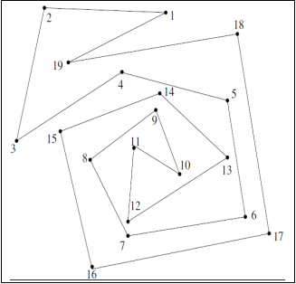
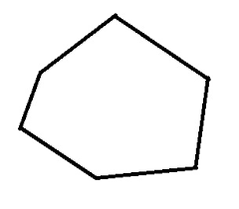
What is Computational Geometry?
The algorithmic and mathematical study of efficient methods to solve geometric problems, mostly in the Euclidean space
Question: Given a polygon P on the 2D plane with n sides, and a query point q, does P include q?
Representation? Choice of origin and axes?
O(n)
O(logn)
P
q
q
Convex polygon: all internal angles < π

Slide 29
Question: Given a polygon P on the 2D plane with n sides, and a query point q, does P include q?
P
q
Courtesy: Gabriel Robins

Slide 30









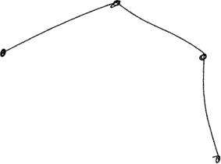


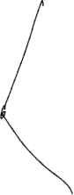

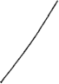
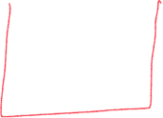




Slide 31


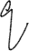




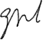

Ref: David Mount, Lecture Notes

Slide 32


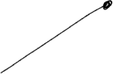
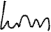
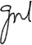
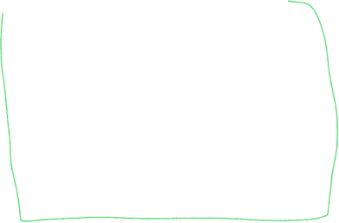


Slide 33






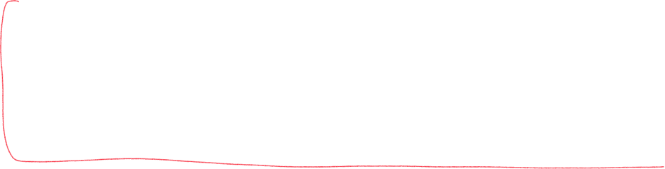



Slide 34
CS60064 Spring 2022 Computational Geometry
Instructors
Bhargab B. Bhattacharya (BBB)
Partha Bhowmick (PB)
Lecture 03
07 January 2022
Indian Institute of Technology Kharagpur
Computer Science and Engineering
Notes:
Good Morning!
The title of today’s talk is “On some Planar Partitioning Problems”.

Slide 35
Point Inclusion in Polygons Orientation Test (contd..)
Notes:
Good Morning!
The title of today’s talk is “On some Planar Partitioning Problems”.

Slide 36


A More General Version: Point Location, Map Navigation
Question: Given a map on a 2D plane and a query point q, determine is which region q is contained
How does a mouse-click work?

Slide 37
Recap:

Slide 38
Orientation Test
Orientation test can be done in O(1) time!
Orientation < 0, for clockwise (CW) p, q, r
= 0, when p, q, r are collinear, or coincide
> 0, for counter-clockwise (CCW) p, q, r

Slide 39
Area of Δ(p, q, r)
Signed area of Δ(p, q, r) = (1/2) ×

Slide 40
If point p is slightly shifted up (right) ideal orientation test should indicate left (right) turn; however, because of finite precision arithmetic, computed value may still indicate collinearity!

Slide 41
Simple polygons: Convex and reflex angles

Slide 43
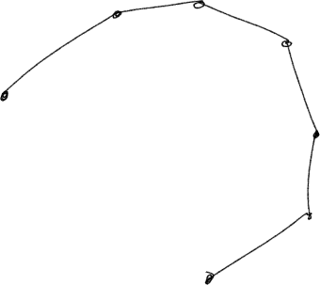



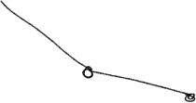





Assuming that the ordered sequence of vertices of P is given in terms of polar coordinates with respect to an interior point

Slide 44
Problem: Given a convex polygon P with n vertices and a query point q, determine whether or not q is internal to P
P
q
not in kernel
q
The same technique holds for
star-shaped polygons as well, provided the kernel is known
Assume that vertices of P have been provided as an ordered sequence of polar coordinates;
The entire plane can be thought as if divided into wedges;
Given a query point q, the corresponding wedge can be located by binary search;
Perform a single orientation test w.r.t. the corresponding edge of P;
O(log n) query time, O(n) space

Slide 45

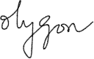

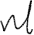



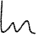

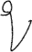

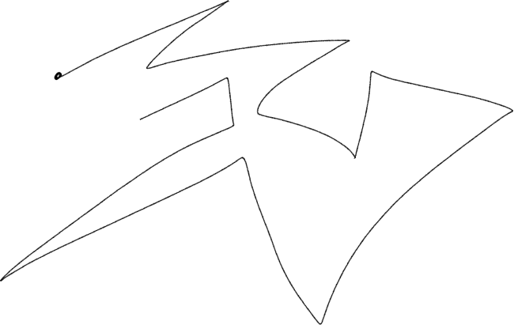



Unidirectional orientation test done as in the convex case, fails here, e.g., while checking orientation (v₁₀, v₁₁, q ), (v₁₁, v₁₂, q)

Slide 46
Ray Shooting
J. O'Rourke: Computational Geometry in C (2nd edition), Cambridge Univ. Press, 1998.
q
Shoot a ray from q and count # intersections with the edges of P
= odd ⇒ q is in the interior of polygon P
= even ⇒ q is in the exterior of polygon P
Beware of degenerate cases!

Slide 47

Winding number
Compute total angular turn around q w.r.t. vertices of P
= 2π ⇒ q is in the interior of polygon P
= 0 ⇒ q is in the exterior of polygon P

Slide 48
Winding number
J. O'Rourke: Computational Geometry in C (2nd edition), Cambridge Univ. Press, 1998.
Compute total angular turn around q w.r.t. vertices of P
= 2π ⇒ q is in the interior of polygon P
= 0 ⇒ q is in the exterior of polygon P

Slide 49
Problem: Given a simple polygon P with n vertices and a query point q, determine whether or not q is internal to P
q
# intersections = 5
1. Ray shooting: Count # intersections with edges, check parity ⇒
O(n) time complexity (degenerate cases cause problems, but overall, the algorithm runs very fast)
2. Winding number: Compute algebraic sum of angular turns spanning all vertices; check whether 2π or 0; ⇒ O(n) time complexity (Note: trigonometric calculations make the algorithm very slow)

Slide 50
Problem (Multiple queries): Given a simple polygon P with n vertices and m query points q₁, q₁, …, q_{m}, determine whether they are internal to P
Ray shooting/winding number: Multiple calls ⇒ O(nm) time,
O(n) space complexity
q_{i}
Can we improve query-time complexity …?
… at the cost of some pre-processing work or space ..?

Slide 51
Problem (Multiple queries): Given a simple polygon P with n vertices and m query points q₁, q₁, …, q_{m}, determine whether or not they are internal to P
Trapezoidal space partitioning
Draw n horizontal lines through each vertex of P dividing the plane into (n – 1 +2) = n + 1 horizontal strips called “slabs”;
Label trapezoids as solid or empty; store descriptions;
Sort the slabs by y-coordinates as a preprocessing step;
Perform a binary search to locate the slab that contains the query point q_{i};
Within this slab, perform a binary search to locate trapezoid that contains the query point q_{i};
Naive: O(nm) time, O(n) space
× × × ×
q_{i}
empty
solid
All queries can be answered in O(mlog n) time using O(n² log n)
preprocessing time and O(n²) space

Slide 52
Beware of trapezoidation in spiral polygons …….; see how pre-processing complexities are determined

Slide 53
Homework Set - 01:
Given n points on 2D-plane, propose an algorithm to construct a simple polygon P with all the given points as vertices, and only those. Provide its proof of correctness and deduce its time complexity. (A simple polygon is one in which no two edges intersect each other excepting possibly at their endpoints.
(a) A convex polygon P is given as counter-clockwise ordered sequence of n vertices in general positions, whose locations are supplied as (x, y) co-ordinates on the x-y plane. Given a query point q, propose an algorithm to determine in O(log n) time and O(n) space, including pre-processing, if any, whether or not P includes q.
(b) Write a code to implement your algorithm. Construct a
convex polygon with 30 vertices, and show your results for a
few internal and external points.
Submit solutions via Moodle. Due: 23:55, January 21, 2022; Credit: 10%

